Slide 1

Module 2 – Video 1 Demand and Revenue
Professor Nico Voigtländer
Management 405: Module 2

Slide 2
outline of module 2
The law of demand
Elasticities
Demand and revenue
Elasticity and revenue
Marginal revenue
Demand estimation
Teaching Note – Demand Elasticity and Total Revenue

Slide 3
Plotting (inverse) Demand
Demand function:
Q = 1,600 – 4P
Rearrange to get inverse
demand function:
P = 400 - Q/4
P
$400
1600
Q
This is the demand function that a firm faces
Notes:
We can now explore the relationship between the elasticity of demand and total revenue. Total revenue is defined as $TR=P∙Q$. Starting at the leftmost portion of the graph, when $Q=0$, we know that $TR=0$. As the price falls, quantity rises. Note that these changes have opposing effects on total revenue. Since we are on the elastic portion of the demand curve, we know that a small decrease in price causes a large increase in quantity, and total revenue increases. This pattern will hold as price falls through the point of unit elasticity on the demand curve. At this point, total revenue reaches its maximum. After this point, we enter the inelastic portion of the demand curve. On the inelastic portion of the demand curve, we know that a small decrease in price causes an even smaller increase in quantity, and total revenue falls. Total revenue continues to fall until the demand curve intersects the x-axis, where $P=0$, and $TR=0$.
When you lower your price and move down the demand curve, there are two effects on revenues: 1) a positive effect from more quantity sold and 2) a negative effect from a lower price per unit. Which area is bigger? It depends on the elasticity of demand.
Case of elastic demand: TR=P×Q. If P ↓ by 10% and Q ↑ by 20%, TR ↑. In the elastic zone of the demand curve (low Q, high P), the revenue curve rises. What can we say about the direction in which profits move here? It is ambiguous because of costs. Since quantity sold is rising, costs are also (weakly) rising. Profit can rise or fall, depending on how much costs increase.
Case of inelastic demand: TR=P×Q. If P ↓ by 10% and Q ↑ by 5%, TR ↓. In the inelastic zone of the demand curve (high Q, low P), the revenue curve is downward sloping. The prescription is clear here. If you are on the inelastic part of the demand curve, raise the price. Revenues rise, you sell less, so costs go down. Since revenues rise and costs go down, you know profits must be going up.
Does that mean that profits are maximized when E_d=-1? No. When E_d=-1, revenues are maximized. Marginal revenue is zero. That is not the same as MR=MC. Only when MR=MC are profits maximized. Usually, this is when E_d<-1, i.e. in the elastic zone of the demand curve, where MR is positive and allows you to cover marginal cost. You only want to stop at MR=0 (E_d=-1) if MC=0.

Slide 4
Relationship between demand and revenue
P
Inverse demand function:
P = 400 - Q/4
Total Revenue: TR = P∙Q
Plug in for P: TR = (400-Q/4) ∙ Q
= 400Q-Q²/4
$400
200
Total revenue
D
800
1600
Q
$160,000
TR
800
1600
Q
Notes:
We can now explore the relationship between the elasticity of demand and total revenue. Total revenue is defined as $TR=P∙Q$. Starting at the leftmost portion of the graph, when $Q=0$, we know that $TR=0$. As the price falls, quantity rises. Note that these changes have opposing effects on total revenue. Since we are on the elastic portion of the demand curve, we know that a small decrease in price causes a large increase in quantity, and total revenue increases. This pattern will hold as price falls through the point of unit elasticity on the demand curve. At this point, total revenue reaches its maximum. After this point, we enter the inelastic portion of the demand curve. On the inelastic portion of the demand curve, we know that a small decrease in price causes an even smaller increase in quantity, and total revenue falls. Total revenue continues to fall until the demand curve intersects the x-axis, where $P=0$, and $TR=0$.
When you lower your price and move down the demand curve, there are two effects on revenues: 1) a positive effect from more quantity sold and 2) a negative effect from a lower price per unit. Which area is bigger? It depends on the elasticity of demand.
Case of elastic demand: TR=P×Q. If P ↓ by 10% and Q ↑ by 20%, TR ↑. In the elastic zone of the demand curve (low Q, high P), the revenue curve rises. What can we say about the direction in which profits move here? It is ambiguous because of costs. Since quantity sold is rising, costs are also (weakly) rising. Profit can rise or fall, depending on how much costs increase.
Case of inelastic demand: TR=P×Q. If P ↓ by 10% and Q ↑ by 5%, TR ↓. In the inelastic zone of the demand curve (high Q, low P), the revenue curve is downward sloping. The prescription is clear here. If you are on the inelastic part of the demand curve, raise the price. Revenues rise, you sell less, so costs go down. Since revenues rise and costs go down, you know profits must be going up.
Does that mean that profits are maximized when E_d=-1? No. When E_d=-1, revenues are maximized. Marginal revenue is zero. That is not the same as MR=MC. Only when MR=MC are profits maximized. Usually, this is when E_d<-1, i.e. in the elastic zone of the demand curve, where MR is positive and allows you to cover marginal cost. You only want to stop at MR=0 (E_d=-1) if MC=0.

Slide 5
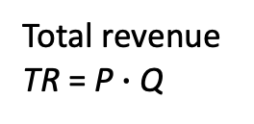
Effect of Price Changes on Total Revenue
A Graphical Approach
Reduction in TR from lower price
Total revenue
TR = P $∙$Q
Increase in TR from higher volume
P₀
P₁
Which area
is bigger?
TR₀
TR₁
Demand
Q₀
Q₁

Slide 6
Own-price Elasticity (E_{d}) and Total Revenue
P
E_{D}<-1 “elastic”
Inverse demand function:
P = 400 - Q/4
E_{D} = -1
-1<E_{D}<0 “inelastic”
D
Q
TR
Elastic region: P falls → Q rises → TR rises
Inelastic region: P falls → Q rises → TR falls
Q
Notes:
We can now explore the relationship between the elasticity of demand and total revenue. Total revenue is defined as $TR=P∙Q$. Starting at the leftmost portion of the graph, when $Q=0$, we know that $TR=0$. As the price falls, quantity rises. Note that these changes have opposing effects on total revenue. Since we are on the elastic portion of the demand curve, we know that a small decrease in price causes a large increase in quantity, and total revenue increases. This pattern will hold as price falls through the point of unit elasticity on the demand curve. At this point, total revenue reaches its maximum. After this point, we enter the inelastic portion of the demand curve. On the inelastic portion of the demand curve, we know that a small decrease in price causes an even smaller increase in quantity, and total revenue falls. Total revenue continues to fall until the demand curve intersects the x-axis, where $P=0$, and $TR=0$.
When you lower your price and move down the demand curve, there are two effects on revenues: 1) a positive effect from more quantity sold and 2) a negative effect from a lower price per unit. Which area is bigger? It depends on the elasticity of demand.
Case of elastic demand: TR=P×Q. If P ↓ by 10% and Q ↑ by 20%, TR ↑. In the elastic zone of the demand curve (low Q, high P), the revenue curve rises. What can we say about the direction in which profits move here? It is ambiguous because of costs. Since quantity sold is rising, costs are also (weakly) rising. Profit can rise or fall, depending on how much costs increase.
Case of inelastic demand: TR=P×Q. If P ↓ by 10% and Q ↑ by 5%, TR ↓. In the inelastic zone of the demand curve (high Q, low P), the revenue curve is downward sloping. The prescription is clear here. If you are on the inelastic part of the demand curve, raise the price. Revenues rise, you sell less, so costs go down. Since revenues rise and costs go down, you know profits must be going up.
Does that mean that profits are maximized when E_d=-1? No. When E_d=-1, revenues are maximized. Marginal revenue is zero. That is not the same as MR=MC. Only when MR=MC are profits maximized. Usually, this is when E_d<-1, i.e. in the elastic zone of the demand curve, where MR is positive and allows you to cover marginal cost. You only want to stop at MR=0 (E_d=-1) if MC=0.

Slide 7
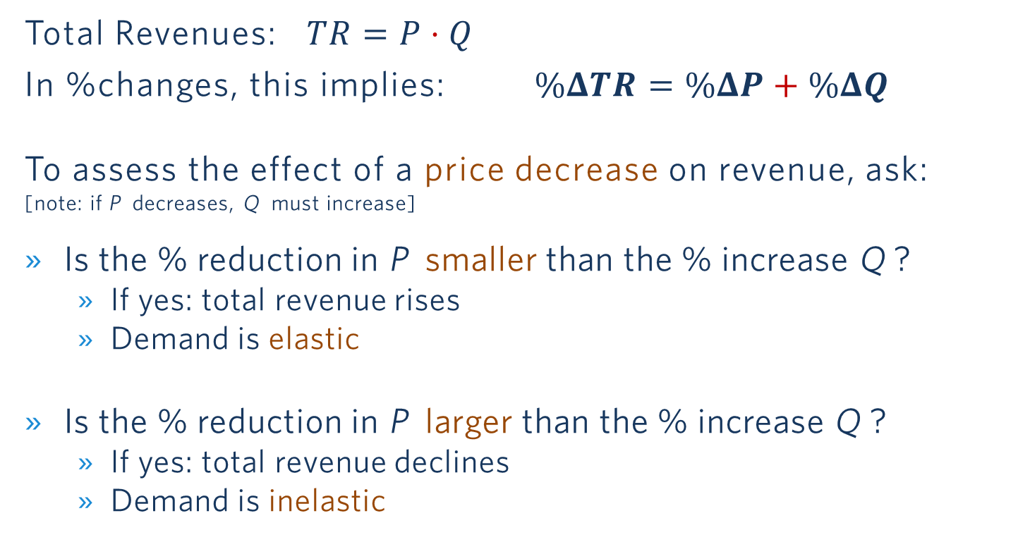
Effect of a Price Change on Total Revenue: It Depends on E_{d}
Total Revenues: $TR=P⋅Q$
In %changes, this implies: $\%ΔTR=\%ΔP+\%ΔQ$
To assess the effect of a price decrease on revenue, ask:
[note: if P decreases, Q must increase]
Is the % reduction in P smaller than the % increase Q ?
If yes: total revenue rises
Demand is elastic
Is the % reduction in P larger than the % increase Q ?
If yes: total revenue declines
Demand is inelastic

Slide 8

Example: Demand for Chewing Gum
Information
Retail prices of Wrigley’s chewing gum increased (slightly)
As a result, the company's sales revenues increased (slightly)
What can we say about the elasticity of demand?
Poll Everywhere break

Slide 9

Notes:
Poll Title: Do not modify the notes in this section to avoid tampering with the Poll Everywhere activity. More info at polleverywhere.com/support Demand for Wrigley's chewing gum is... https://www.polleverywhere.com/multiple_choice_polls/geg4OW3J173fOJpvFakHJ?flow=Default&onscreen=persist

Slide 10
Solution
Demand is inelastic
A price increase caused total revenue to increase
This means that %change in price was larger than the %decline in quantity → inelastic response of quantity to the price change

Slide 11
Summary: Effect of a Price Change on Total Revenue: It Depends on E_{d}
Is the percent reduction in price greater or smaller than the percent increase in quantity sold?
More precisely: is demand elastic or inelastic?
% Change in P | Resulting % Change in Q | Demand is… | Resulting Change in Revenue
If P decreases | & Q increases by MORE than P falls | Elastic | Revenue increases
If P decreases | & Q increases by LESS than P falls | Inelastic | Revenue decreases
If P increases | & Q decreases by MORE than P rises | Elastic | Revenue decreases
If P increases | & Q decreases by LESS than P rises | Inelastic | Revenue increases

Slide 12
OUTLINE of module 2
The law of demand
Elasticities
Demand and revenue
Elasticity and revenue
Marginal revenue
Demand estimation

Slide 13
Why do we care about marginal revenue?
General objective: Maximize net benefits
Use marginal analysis
Rule: net benefits are maximized where MB = MC
Example: Optimal amount of running
Firms’ objective: Maximize profits
Rule: produce where
Marginal Revenue = Marginal Cost
MR = MC
Today: how to compute MR

Slide 14
Marginal revenue: definition
Intuitively: Additional revenue from selling one more unit
Mathematically: How much total revenue changes when quantity sold increases by 1 unit
$$MR=\frac{∆TR}{∆Q}\text{"=}"\frac{dTR}{dQ}$$
How to compute MR : start from the demand function and use a 3-step method
Derivative

Slide 15
CALCULUS REFRESHER: Derivatives
$\frac{dY}{dX}$: derivative of Y with respect to X
Corresponds to the change in Y due to a small (marginal) change in X
Suppose $Y = a + bX + cX^{2}$
Where a,b,c are constants
E.g., a=1, b=3, c=2 → $Y =1 +3X +2X^{2}$
Then: $\frac{dY}{dX}=b+2cX$
In the above example: $\frac{dY}{dX}=3+2⋅2⋅X=3+4X$
See TA’s Math Review Videos

Slide 16
3 step method in action
Suppose demand is: $Q=1,600−4P$
Calculate inverse demand (solve for P ):
Result: P $=400−\frac{1}{4}Q$
Calculate total revenue (multiply P by Q ):
Result: $TR=\left(400−\frac{1}{4}Q\right)∙Q=400∙Q−\frac{1}{4}{∙Q}^{2}$
Calculate marginal revenue from total revenue ($MR={dTR}/{dQ}$)
Result: $MR=400−(2⋅\frac{1}{4})∙Q=400−\frac{1}{2}Q$
Notes:
Marginal Revenue = Marginal Cost when Demand is Linear
To set MR=MC, you need to know MC. For now, we assume a constant marginal cost: MC=$200. The harder part is MR. What is marginal revenue? In words, it is the change in revenues when you sell one more unit of the good. To get there, we want to find out what total revenue is only as a function of Q, so that we can take the derivative of revenue with respect to Q.
Let's write down a specific demand function and work through an example using this demand function:
Q=1600-4P
The Recipe
There are three steps to get to the mathematical answer for MR. You can apply this recipe whenever you face this type of problem:
Invert your demand. That's the inconvenient legacy of Alfred Marshall that I mentioned in class:
P=400 - 1/4 Q
(If you're wondering what I did here, I just took our demand function, put P on the left side, Q on the right side and divided everything by 4).
Write down total revenue. What's total revenue? It is P times Q. So:
PQ=400Q-1/4 * Q^2
(Here I just multiplied the previous equation by Q: easy!)
Find Marginal Revenue. That's the hardest step. It entails taking the derivative of PQ with respect to Q. You may or may not know any calculus. But (I promise!) you can do this even if you don't know any calculus. All you need to know is that the derivative of Q with respect to Q is 1, and that the derivative of Q² with respect to Q is 2Q:
MR=(∆PQ)/∆Q=400-1/2Q
So now we have MR. You will notice that MR has twice the slope of the inverse demand function. The slope of the inverse demand function is -1/4 and the slope of MR is -1/2. When demand is linear, MR is always twice as steep as demand.
Where MR=0, demand is unit elastic
Try to understand intuitively why the elasticity of demand is exactly -1 when MR=0!
Total revenue is maximized where E_d=-1. If MR>0, then TR must be rising as Q increases. If MR<0, then TR must be declining.
Note that your goal is to maximize profits, not total revenue. A consideration of costs matters.
Now we set MR equal to MC ($200) and we are done:
MR=MC
400-12Q=200
Q=400
So now we know that maximizing profits entails setting Q=400. What about the price P? Well, that's easy to find: our price-quantity combination must be located on the demand curve. So from the inverse demand we derived earlier, we find:
P=400-1/4Q=400-100=$300
Maximizing profits, here, entails setting Q=400 units and P=$300.

Slide 17
The “3 step method”: Summary Notes
Calculate inverse demand
Rearrange demand such that P is expressed as a function of Q (see Module 2, Video 1)
Calculate total revenue
$TR=P∙Q$
Replace P by inverse demand so that TR is expressed as a function of Q only
Calculate marginal revenue from total revenue
Derivation of TR with respect to Q
PS 2 + Teaching Note Marginal Revenue

Slide 18
Mr: graphical representation
P
400
$$Q = 1,600 – 4P$$
Elastic portion
$$P = 400 – Q/4$$
MR
E_{D} = -1
$$TR = 400Q – Q²/4$$
$$MR = 400 – Q/2$$
Inelastic portion
D
800
1600
Q
TR is max. where MR=0
TR
800
Q
Notes:
Why isn’t MR just P?
For a firm with market power (which we will assume here), they will face downward sloping demand. In order to sell additional unit, it will have to lower the price. It will lower the price not just for the marginal unit, but for all units. This reduces the revenue the firm receives for the other units it sells. When computing the marginal revenue from the additional unit, it must also subtract the loss it suffers on every other unit.
Is there any situation under which MR=P?
Infinite elasticity. When the good is perfectly elastic, a firm doesn’t have to lower the price in order to sell more goods [quantity doesn’t depend on price]; the firm can sell any amount at a given price, so marginal revenue just equals P. This is known as perfect competition, which we will return to in the second half of the course when we discuss market power.
Can MR be negative?
Yes! In the left side of this plot, we see that MR is negative. To the right of the point of unit elasticity, TR is declining, meaning that each additional unit contributes negatively. That is another way of saying that MR is negative.

Slide 19
Why is mr different from the price?
MR : additional revenue from selling one more unit. Sounds like the price! But…
Law of demand: you need to lower the price to sell one more unit
The lower price will apply to all units, not just the extra one
MR from selling one additional unit takes into account the loss on every other unit → MR<P
Note: Total Revenues (TR ) may either increase or decrase when Q increases. (Depends on elastic vs. inelastic demand)

Slide 20

Notes:
Poll Title: Do not modify the notes in this section to avoid tampering with the Poll Everywhere activity. More info at polleverywhere.com/support What is Marginal Revenue when Q=10-0.5P? https://www.polleverywhere.com/multiple_choice_polls/C5Wxwwh4hdr3oNiTVckkc?flow=Default&onscreen=persist

Slide 21
Solution: If $Q=10−0.5P$, what is MR ?
Inverse Demand: $P=20−2Q$
Total revenue$: TR=P∙Q$
$$TR=\left(20−2Q\right)∙Q=20Q−2Q\text{2}$$
Derivative of TR w.r.t. Q.
$$MR=\frac{dTR}{dQ}=20−4Q$$

Slide 22
OUTLINE of module 2
The law of demand
Elasticities
Demand and revenue
Elasticity and revenue
Marginal revenue
Demand estimation
Problem Set 2

Slide 23
How to estimate a demand curve?
Use regression analysis to estimate the relationship between price and quantity
Need data linking prices and quantities
Several approaches
Transaction data (marketing research firms, internet, « Ralph cards »)
Surveys
Market experimentation
Notes:
Here we can say that we'll focus on market experimentation = cleanest way + increasingly ued thanks to new technologies + we'll discuss at the end why better than using transaction data

Slide 24
Econometric estimates
Description: Combination of economics, statistics, and mathematical model building
Develop hypotheses about relationships between dependent variables (quantity sold) and independent/explanatory variables (e.g., price)
Common method: Least squares regression

Slide 25
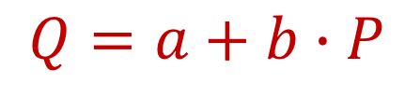
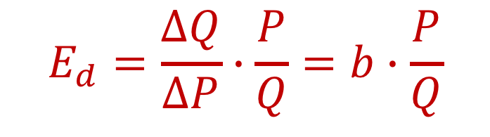
Ordinary Least Squares The Basic Equation
$$Q=a+b∙P$$
where:
Q = Quantity sold (dependent variable)
P = Price (explanatory variable)
a = Intercept with y-axis (Q is on y-axis)
b = Slope of regression line
Slope
$$E_{d}=\frac{ΔQ}{ΔP}∙\frac{P}{Q}=b∙\frac{P}{Q}$$
Notes:
The basic equation is a demand equation: Q=a+bP. We expect b<0, because that determines that the own-price elasticity is negative.

Slide 26
Airline Ticket experimentation
Price
250.00
265.00
265.00
240.00
230.00
225.00
225.00
220.00
230.00
235.00
245.00
240.00
250.00
240.00
240.00
235.00
Seats Sold
64
33
37
83
111
137
109
96
59
83
90
105
75
91
112
102

Slide 27
First Pass: eyeball the relationship …Is it Approximately Linear?
Quantity
Scatterplot of Q versus P
Price ($)

Slide 28
Least Squares Estimation which Line provides the Best Fit?
Quantity
Least Squares Algorithm:
Calculate all vertical distances
Square them
Sum them over all data points
Choose the line that minimizes the sum of squares.
Price ($)

Slide 29

Regression results I
(from excel using “data analysis”)
coefficient | value
Constant (intercept) | 479
Own price | -1.64
Demand Equation:
$$Q=479−1.64P$$
Note: Now that we have demand, we can compute MR!
More detail: “Teaching Note Regressions”
Notes:
The intercept term is the value of a: horizontal intercept. When the price is zero you sell 479 units.
The price has a negative coefficient: b=-1.64. Price and volume are inversely related, as in a demand function. For every unit you drop the price, you get a 1.64 unit expansion in volume sold.
So now we have our values for a and b, respectively.

Slide 30
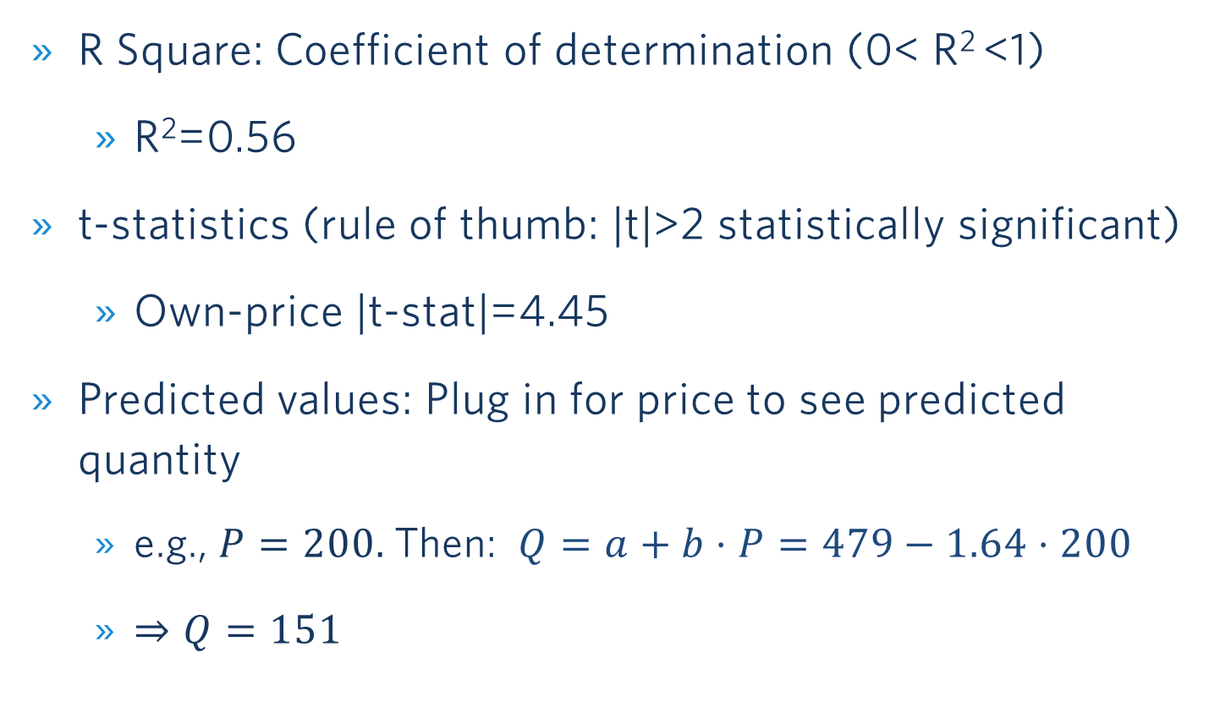
Regression results II
R Square: Coefficient of determination (0< R² <1)
R²=0.56
t-statistics (rule of thumb: |t|>2 statistically significant)
Own-price |t-stat|=4.45
Predicted values: Plug in for price to see predicted quantity
e.g., $P=200.$ Then: $Q=a+b⋅P=479−1.64⋅200$
$⇒Q=151$
Notes:
Other reported statistics (by Excel, R, or Stata) are interesting.
— The first is a measure of FIT. The better the overall fit, the closer the data points are to the regression line, i.e. the regression line captures a lot of the variation in the data. A measure of what we can explain. Here R² is about 60%. We can explain 60% of the variation in quantity only using the price. Not bad, but there is room for improvement – 40% to be precise. The logical next step is to try to explain more. You can do that by adding more variables on the right hand side. If all the points were exactly on the regression line, we would have R²=1. Needless to say, that is almost never the case.
The second set of statistics measure statistical significance – i.e. how precisely each individual coefficient is measured. You can look at the standard error of your estimate, or the t-statistic that is simply the coefficient divided by the standard error. The rule of thumb is you want the absolute value of the t-statistic to be greater than 2 – for enough precision you want your coefficient to be twice the magnitude of its standard error. Then you can be 95% certain that the true coefficient is different from zero

Slide 31
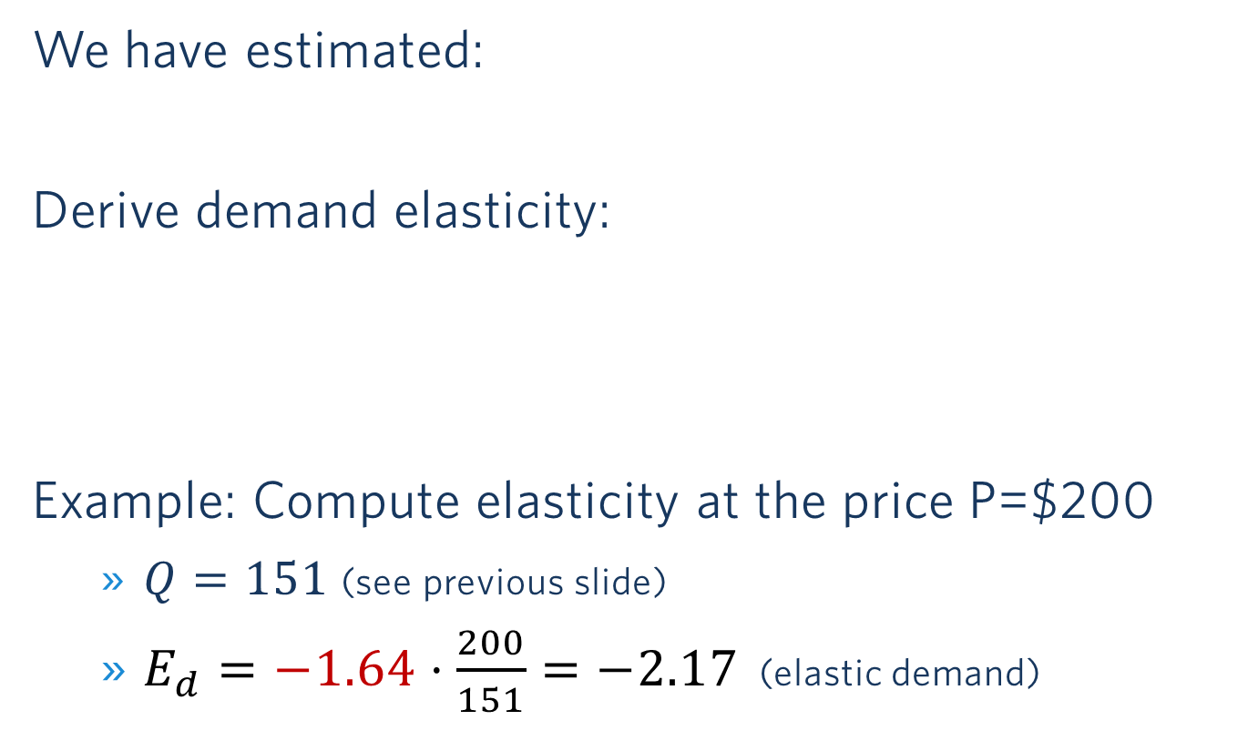
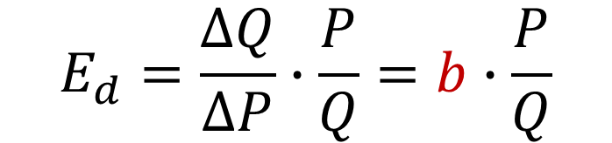

Obtain Elasticity from Estimated Demand Curve
$$Q=a+b∙P$$
We have estimated:
Derive demand elasticity:
Example: Compute elasticity at the price P=$200
$Q=151$ (see previous slide)
$E_{d}=−1.64⋅\frac{200}{151}=−2.17$ (elastic demand)
Slope
$$E_{d}=\frac{ΔQ}{ΔP}∙\frac{P}{Q}=b∙\frac{P}{Q}$$
Notes:
The basic equation is a demand equation: Q=a+bP. We expect b<0, because that determines that the own-price elasticity is negative.

Slide 32
MULTIVARIATE REGRESsion
$$Q=a+b∙P+c∙P_{c}+d∙Y$$
where:
Q = amount purchased
P = own price
P_{c} = competitor's price
Y = income
Notes:
So, can we do better than an R² of 0.59? Yes. Economics tells us a lot of other things besides your own price drive demand: income, price of substitutes, how much you spend on promotion and advertising, etc. So let’s include them in the regression and see what happens. -> even if we have randomized prices, these factors might change and including them will increase precisions
The multivariate model includes two additional regressors or independent variables:
1. There is a competitor with a substitute product available (say United versus American)
2. You have data on average income in the US at the time of the sales. That is a factor that influences demand (what is the expected direction? Positive if air travel is a normal good).
Move to multiple regression module of the Excel workbook. Units are $ for price but an index for the income level. Run a multivariate regression of quantity on own price, price of substitute and income. The dependent variable stays the same, the independent variables now include Y and P^{c}.
On Problem Set 2, you will have the opportunity to run a regression, and interpret and use the coefficients!

Slide 33
Results with added variables
coefficient | value
Constant (intercept) | 28.8
Own price | -2.12
Competitor’s price | 1.03
Income | 3.09
Demand Equation:
$$Q=28.8−2.12P+1.03P_{c}+3.09Y$$
Notes:
What has changed?
The coefficient on P^{c}, which is dQ/dP^{c}, equals 1.04. This indicates how my quantity sold changes with a one unit change in the competitor’s price. Since the product is a substitute, I expect a positive sign, which is what we get.
The coefficient on Y is 3.09 indicating a normal good. For every 1 point increase in the index of income, you get a 3.09 increase in airline seats sold.
You can derive elasticities from these numbers.
There is not much meaning to the intercept here – value of Q is all the independent variables are zero.
Note that R² (which is not stated on this slide) is now up to 0.88, which mean 88% of the variation in Q is explained by our model, so we are doing much better. R² always goes up when you include more variables, but how much it goes up matters.

Slide 34
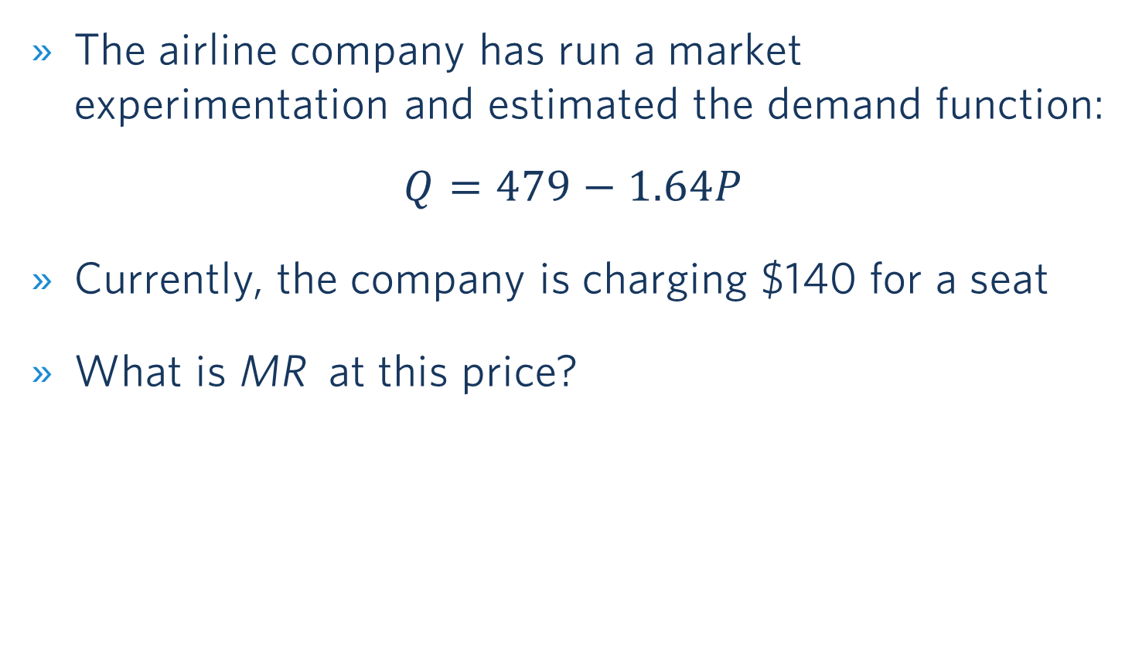
Application
The airline company has run a market experimentation and estimated the demand function:
$$Q=479−1.64P$$
Currently, the company is charging $140 for a seat
What is MR at this price?
Poll Everywhere break

Slide 35
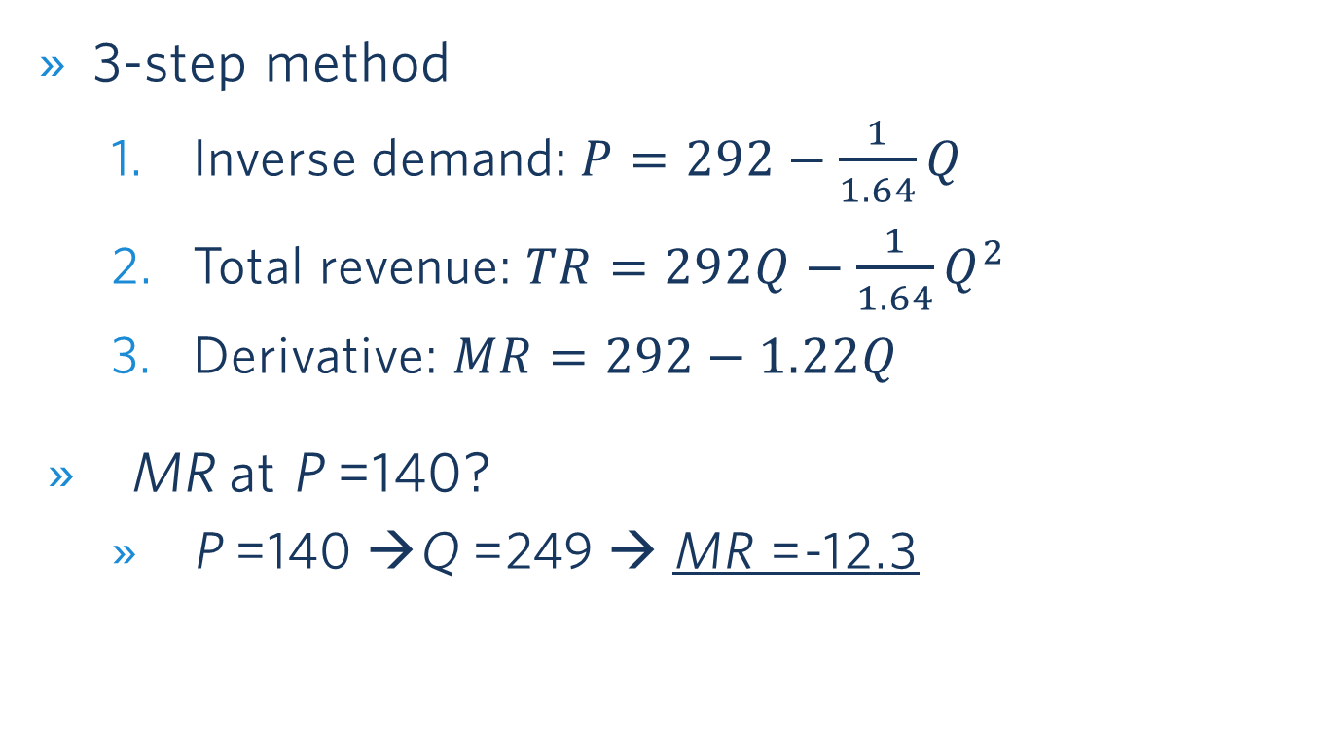
Solution
3-step method
Inverse demand:$P=292−\frac{1}{1.64}Q$
Total revenue: $TR=292Q−\frac{1}{1.64}Q^{2}$
Derivative: $MR=292−1.22Q$
MR at P =140?
P =140 →Q =249 → MR =-12.3

Slide 36
solution
MR is negative so you want to sell less
How do we sell less? By increasing the price
P
Elastic portion
MR
E_{D} = -1
Inelastic portion
D
Q
Notes:
Then we show the graph to say that when MR is negative it means you are in the inelastic portion and in this portion you always want to increase the price + we can ask them
Then which value do you expect for the elasticity at the current price (should answer absolute value below 1)
How would you compute it? + if time could be done on the board

Slide 37
Issues with transaction data why randomization is key
Transaction data: evolution of prices and quantities over time, across locations, stores…
Can we be sure that the change in quantity purchased is due to price changes?
Example: in August 2019, the airline sold 135 tickets for $200; in October, 90 tickets for $180
Should we conclude that the demand curve is upward sloping?
What can confound the analysis?

Slide 38


Correlation does not mean causation
Newspaper headline: "Drinking Three Cups of Coffee a Day Reduces Risk of Heart Attack”
(causal statement)
Actual finding in study: "Among coffee drinkers, there is a smaller risk of serious cardiovascular diseases”

Slide 39


Correlation does not mean causation
Potential Problem: other factors (e.g., lifestyle) are driving the correlation
Notes:
We call this omitted variable bias.
https://www.thegreatcoursesdaily.com/correlation-or-causality-wine-and-heart-health/
“But experts warn that the two studies, both published in the Annals of Internal Medicine, do not show that drinking coffee was behind the overall lower risk, pointing out that it could be that coffee drinkers are healthier in various ways or that those who are unwell drink less coffee. In addition, levels of coffee drinking were self-reported.”

Slide 40
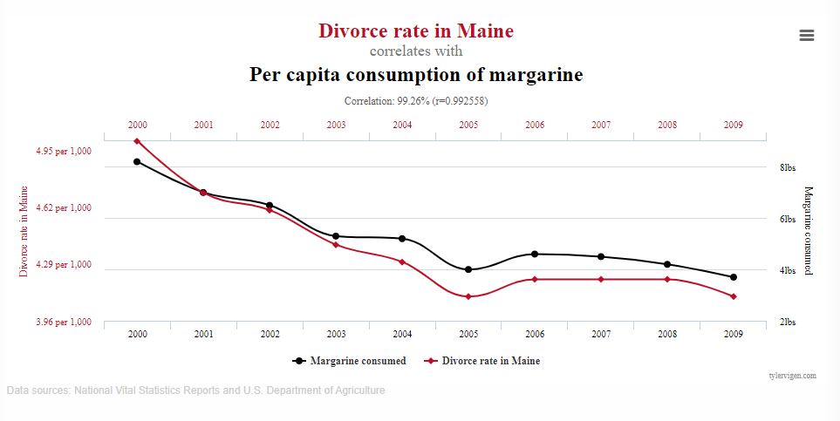
Spurious correlations
https://www.tylervigen.com/spurious-correlations

